Slide 1

Melanoma Skin Cancer Diagnosis Using Machine Learning
Final Year Project Defense Presentation
Muhammad Yahya Khan FA17-ECE-027
Qasim Ashraf FA17-ECE-032
Supervised By
Dr. Shahzad A. Malik
Department of Electrical and Computer Engineering
COMSATS University Islamabad

Slide 2
Agenda of Presentation
Introduction
Techniques
Literature Review
Problem Statement
Process Flow Diagram
Block Diagram
Methodology
Results
Conclusion
Bibliography

Slide 3
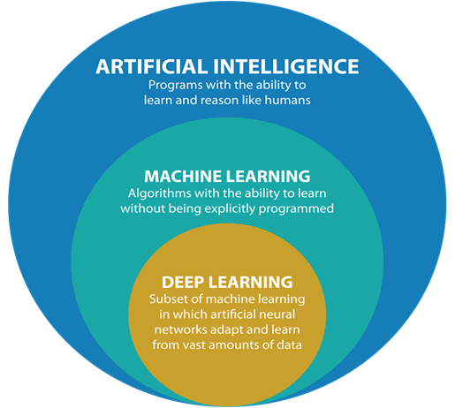
Introduction
AI, Machine Learning & Deep Learning:
What is Artificial Intelligence?
What is Machine Learning?
What is Deep Learning?

Slide 4
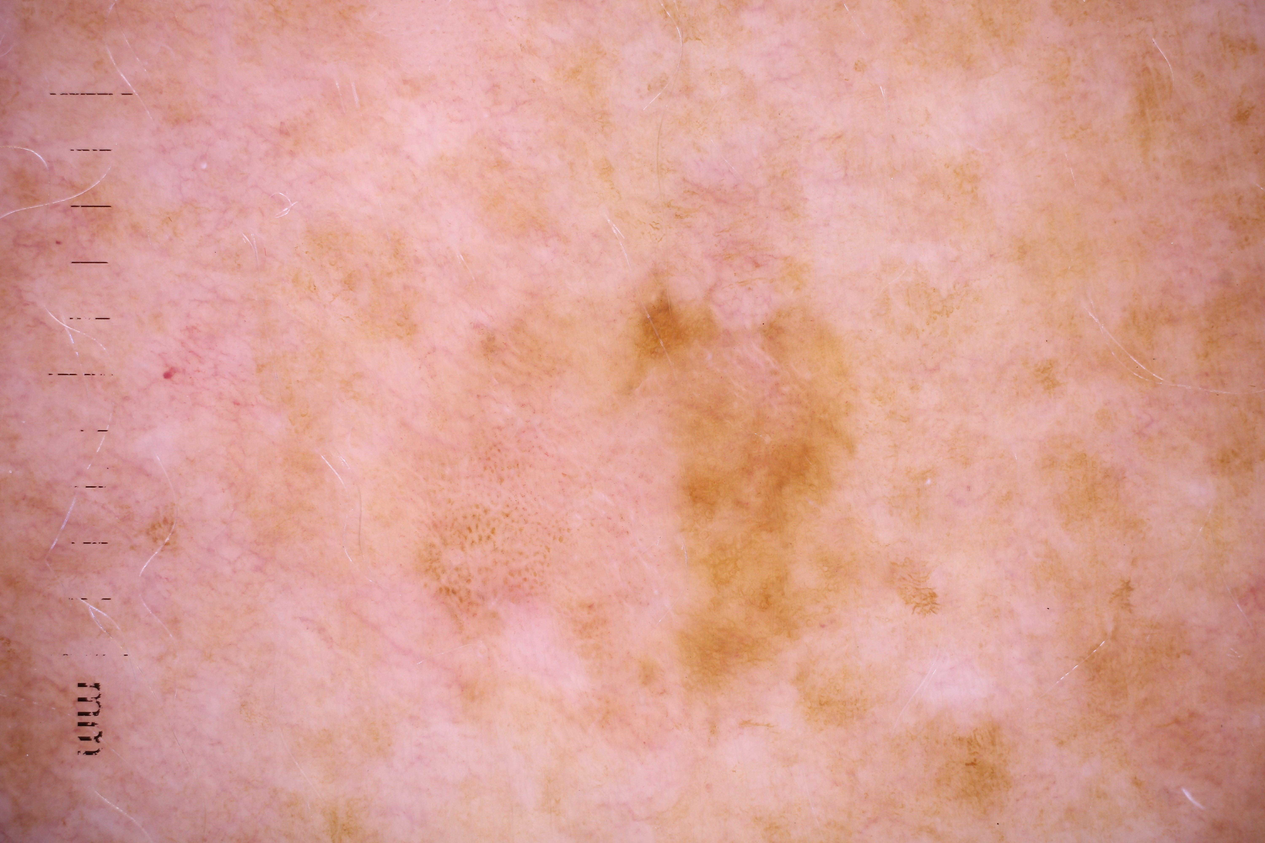
Introduction
Melanoma:
It is a form of skin cancer
It develops when melanocytes start to grow out of control
It is less common but more dangerous
Can it be fatal?
Can it be treated?
Malignant Tumor

Slide 5
Introduction
Scope of Machine Learning in Medical Diagnosis:
First report of machine learning application
Recent developments
Convolutional neural networks

Slide 6
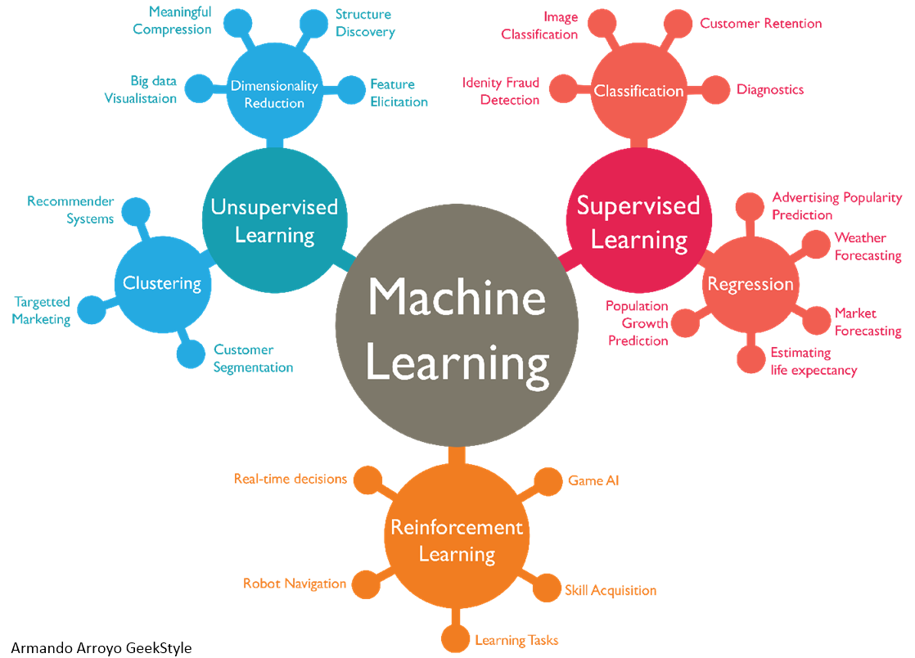
Introduction
Machine Learning has the following types:
Supervised Learning
Classification
Image Classification
Regression
Unsupervised Learning
Reinforcement Learning

Slide 7
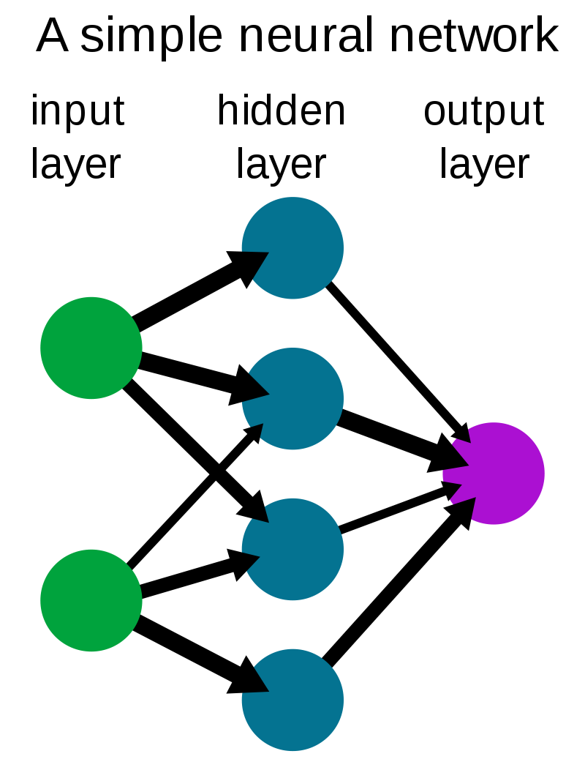
Techniques
Neural Networks:
What is a neural network?
What is it used for?
How does it work?

Slide 8
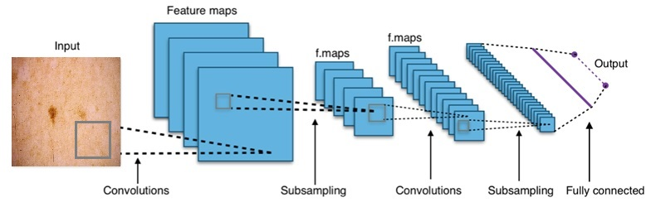
Techniques
Convolutional Neural Network:
It consists of an input and an output layer, as well as multiple hidden layers.
The hidden layers typically consist of convolutional layers.

Slide 9
Techniques
Why CNNs?
Learning feature representation
Parallel processing over GPUs
They have been shown to perform much better in image analysis compared to other technologies [4]

Slide 10
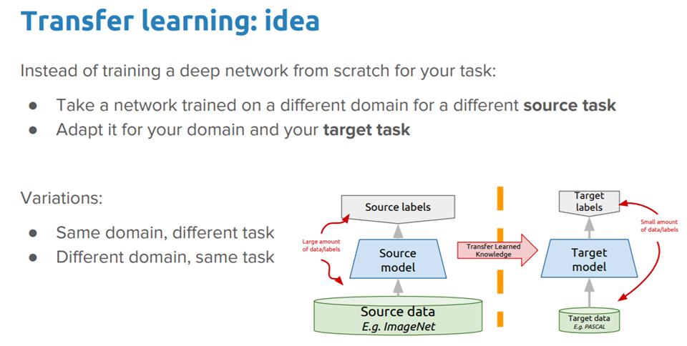
Techniques
Transfer Learning:
What is transfer learning?
Why is it useful?
How is it effective?

Slide 11
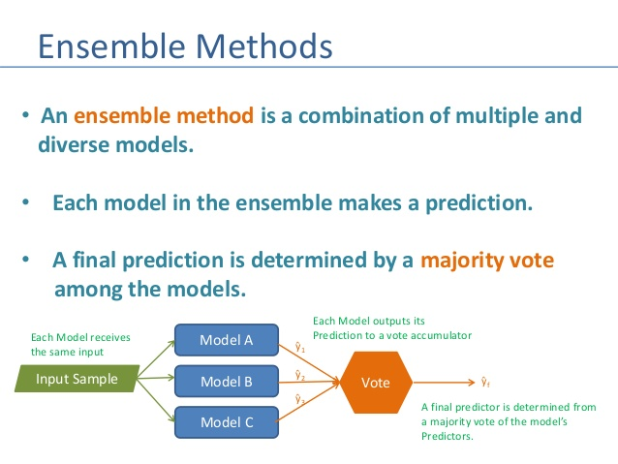
Techniques
Ensemble Learning:
What is Ensemble technique?
Why is it useful?
How is it used?

Slide 12
Literature Review
Paper | Authors | Conclusion
Artificial Intelligence-Based Image Classification for Diagnosis of Skin Cancer: Challenges and Opportunities [1] | Manu Goyal, Thomas Knackstedt, Shaofeng Yan, Saeed Hassanpour | In this paper, the technical challenges of the algorithms are discussed in the digital dermatology and opportunities to improve the current AI-based image classification solutions so that they can be used as a support tool for clinicians to enhance their efficiency in diagnosing skin cancers.
Skin Lesion Classification Using Loss Balancing and Ensembles of Multi-Resolution EfficientNets [2] | Nils Gessert, Maximilian Nielsen, Mohsin Shaikh, Ren´e Werner, and Alexander Schlaefer | In this paper, it was found that EfficientNets perform well for skin lesion classification. In the final ensemble strategy, various EfficientNets were present, although the largest ones performed best. This indicates that a mixture of input resolutions is a good choice to cover multi-scale context for skin lesion classification.
Deep Ensemble Learning for Skin Lesion Classification from Dermoscopic Images [3] | A. H. Shahin, A. Kamal and M. A. Elattar | This paper introduces an ensemble-based deep learning approach that helps dermatologists distinguish between seven different types of skin lesion categories. When compared to previous lesion classification approaches, the ensemble approach using these networks produced significantly better results.

Slide 13
Literature Review
State of the Art CNNs (Why are these the best?):
ImageNet:
It is a large visual database designed for use in visual object recognition software research.
The following are the architectures that we have used:
EfficientNet
MobileNet
ResNet
VGG
Xception

Slide 14
Problem Statement
How are machine learning applications used to diagnose skin cancer?
The task was to implement machine learning application on cancer images using both transfer learning and ensemble learning techniques and identify between benign and malignant images.

Slide 15
Process Flow Diagram
Input (Skin Cancer Images)
Classifier 1
Classifier 2
Classifier 11
Ensemble Network
Output (Malignant or Benign Melanoma)

Slide 16
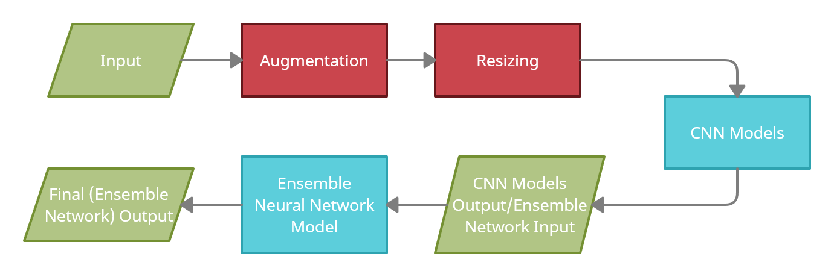
Block Diagram

Slide 17
Methodology (Dataset)
ISIC 2020 Challenge Dataset:
The dataset was generated by the International Skin Imaging Collaboration (ISIC).
There are 33126 training samples.
Benign Images: 32,542
Malignant Images: 584 and 44,880 (after augmentation)

Slide 18
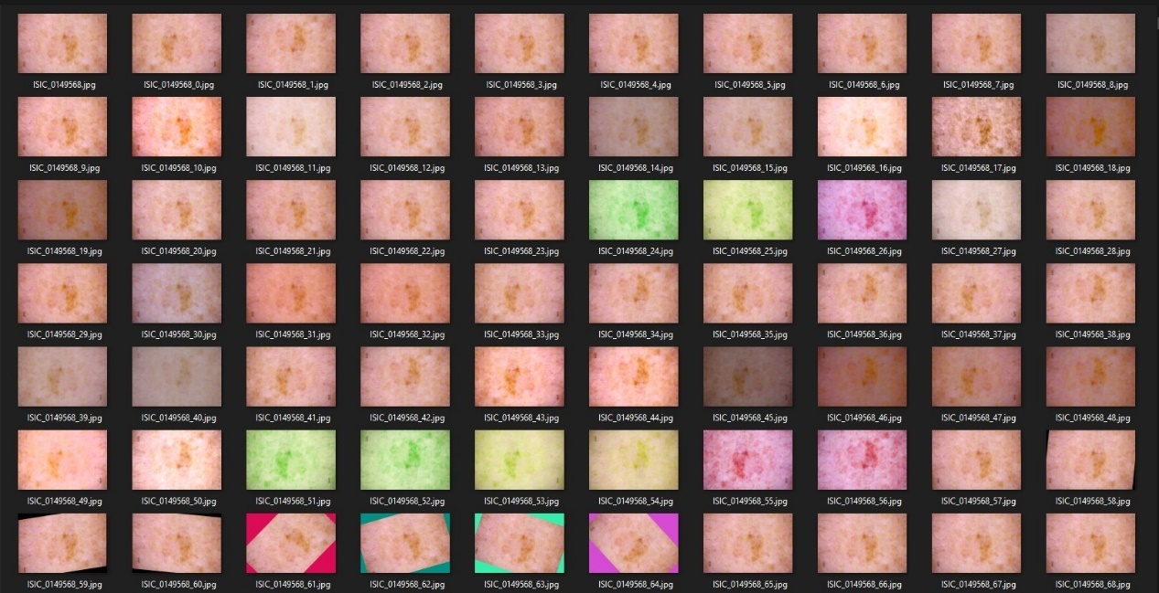
Methodology (Preprocessing)
Augmentation:
What is augmentation?
Why is it used?
How is it effective?
Ratio before: 2-98
Ratio after: 55-45

Slide 19

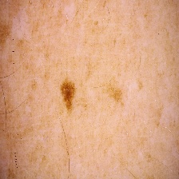
Methodology (Preprocessing)
Resizing:
What is resizing?
Why do we need it?
Original Image (6000x4000) pixels
Resized Image (224x224) pixels

Slide 20
Methodology (Training)
Machine Learning Framework used:
Keras & TensorFlow
Training Parameters:
Image Size
Activation
Optimizers
Epochs
Batch Size
Output Functions:
Metrics
Losses

Slide 21
Methodology (Training)
CNN Architectures:
Activation function used: Sigmoid
Optimizer function used: Adam
Metric function used: Accuracy
Loss function used: Binary Cross-Entropy
Model Name | Image Size | Epochs | Batch Size
EfficientNet-B0 | 224 x 224 | 6 | 32
EfficientNet-B1 | 240 x 240 | 6 | 32
EfficientNet-B2 | 260 x 260 | 6 | 16
EfficientNet-B3 | 300 x 300 | 6 | 16
MobileNet | 256 x 256 | 3 | 32
MobileNetV2 | 256 x 256 | 3 | 32
ResNet50 | 224 x 224 | 6 | 32
ResNet50V2 | 224 x 224 | 6 | 32
VGG16 | 224 x 224 | 6 | 32
VGG19 | 224 x 224 | 6 | 32
Xception | 299 x 299 | 6 | 16

Slide 22
Results
CNN Architectures:
The Best and worst CNNs on our dataset (In terms of accuracy):
MobileNetV2 (Best)
VGG16 (Worst)
Average
Network Name | Train Loss | Validation Loss | Train Accuracy | Validation Accuracy
EfficientNet-B0 | 0.0130 | 1.5180 | 0.9956 | 0.7431
EfficientNet-B1 | 0.0101 | 1.7929 | 0.9968 | 0.7620
EfficientNet-B2 | 0.0103 | 2.8518 | 0.9998 | 0.7190
EfficientNet-B3 | 0.0089 | 1.8636 | 0.9971 | 0.7430
MobileNet | 0.0174 | 0.8588 | 0.9949 | 0.7844
MobileNetV2 | 0.0280 | 0.9225 | 0.9900 | 0.8098
ResNet50 | 0.0124 | 1.6049 | 0.9964 | 0.7414
ResNet50V2 | 0.0127 | 1.8766 | 0.9957 | 0.7035
VGG16 | 0.0233 | 1.4696 | 0.9926 | 0.6960
VGG19 | 0.0269 | 2.0235 | 0.9908 | 0.7039
Xception | 0.0073 | 1.3922 | 0.9977 | 0.7296
Average | 0.0154 | 1.6522 | 0.9952 | 0.7396

Slide 23
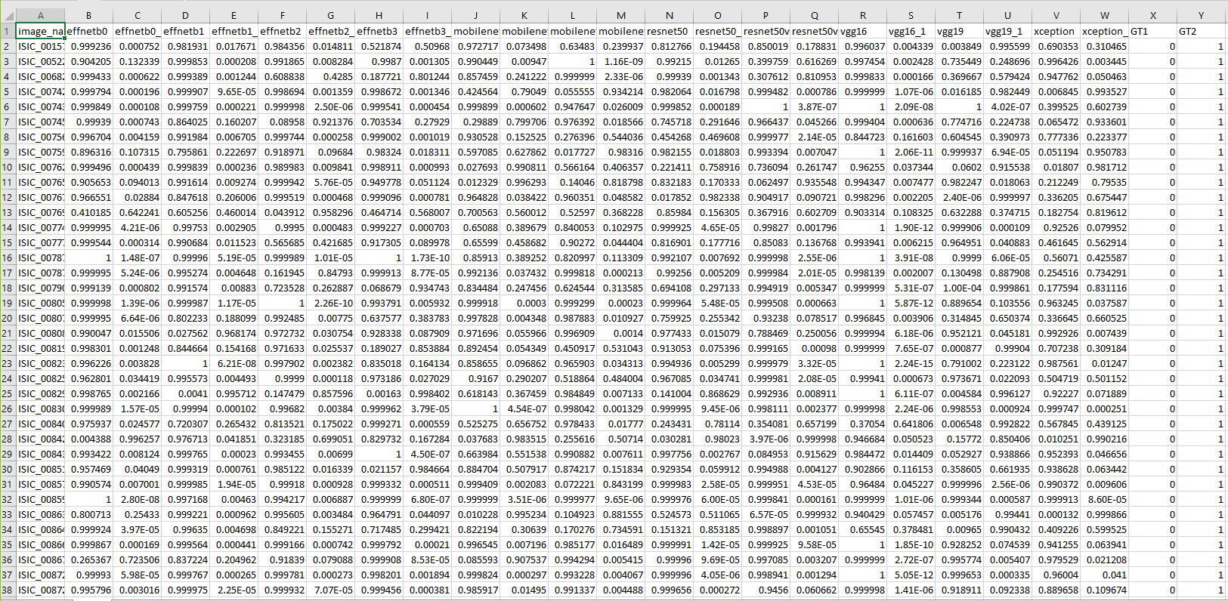
Results
CNN Models Prediction:
Column A contains image names
Columns B to W contain outputs of various CNNs
Columns X and Y contain ground truth from the dataset

Slide 24
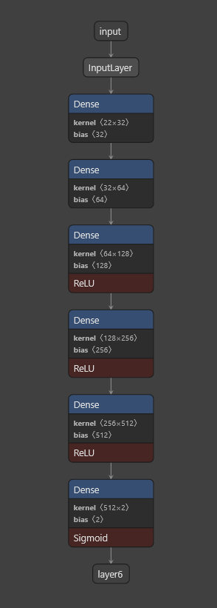
Methodology (Training)
Ensemble Network:
A new neural network with 6 dense layers.
Input layer: 22 nodes
Hidden layers: 32, 64, 128, 256, 512 nodes respectively
Output layer: 2 nodes
How does it work?
Input: Prediction of CNN Models
Output: Ground Truth given in the dataset.

Slide 25
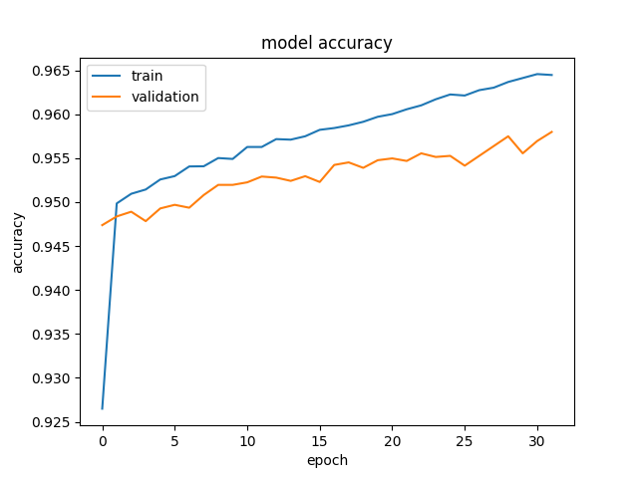
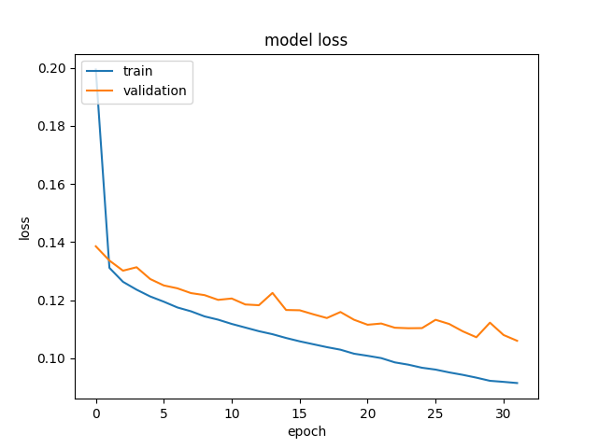
Results
Ensemble Network:
Accuracy & Loss:
Training accuracy: 96.45%
Validation accuracy: 95.80%
Training Loss: 0.0914
Validation Loss 0.1060
Test Accuracy: 70.25%

Slide 26
Conclusion
Multiple CNN models have been used to classify images, best accuracy we could achieve was around 80%.
Ensemble network was then used to classify images, the accuracy was around 95%.
Accuracy was improved by 15% due to the ensemble network.
Machine learning is an effective way to diagnose skin cancer, if we have an adequate dataset.

Slide 27
Bibliography
[1] Goyal, M., Knackstedt, T., Yan, S., & Hassanpour, S. (2020). Artificial intelligence-based image classification for diagnosis of skin cancer: Challenges and opportunities. Computers in Biology and Medicine, 104065.
[2] Gessert, Nils, et al. "Skin lesion classification using ensembles of multi-resolution EfficientNets with meta data." MethodsX 7 (2020): 100864.
[3] A. H. Shahin, A. Kamal and M. A. Elattar, "Deep Ensemble Learning for Skin Lesion Classification from Dermoscopic Images," 2018 9th Cairo International Biomedical Engineering Conference (CIBEC), Cairo, Egypt, 2018, pp. 150-153, doi: 10.1109/CIBEC.2018.8641815.
[4] Olga Russakovsky JD, Hao S, Krause J, Satheesh S, Ma S, Huang Z, et al. ImageNet large scale visual recognition challenge. Int J Comput Vis. 2015;115(3):211–52.

Slide 28
Thank You!

